Slide 1
Expression Sequences and let-blocks

Slide 2
Expression sequences
Expression sequence is a semi-colon separated list of expressions.
expressionSeq ::= expression ; expressionSeq
| expression
…
base ::= ( expressionSeq ) | integer | …

Slide 3
Evaluation
The expressions in an expression sequence are evaluated from left-to-right.
The value of an expression sequence is the value of the last expression in the sequence
(e₁; e₂; …; e_{n})
→* (v₁; e₂; …; e_{n})
→* (v₁; v₂; …; e_{n})
…
→* (v₁; v₂; …; v_{n})
→ v_{n}

Slide 4
purpose
Expression sequences are used for side-effects.
The side-effects in which we are interested revolve around printing output to standard out (aka, the screen).

Slide 5
Example 1
(
print “\n5\n”;
print “\n4\n”;
print “\n3\n”;
print “\n2\n”;
1
);

Slide 6
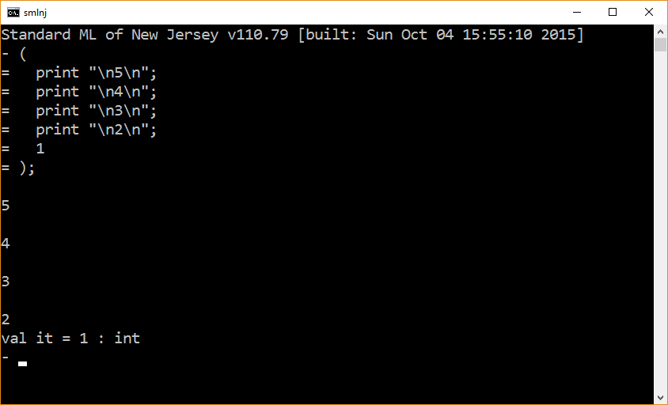

Slide 7
Example 2
val x = (
print “\nAssigning 5 to x\n”;
5
);

Slide 8
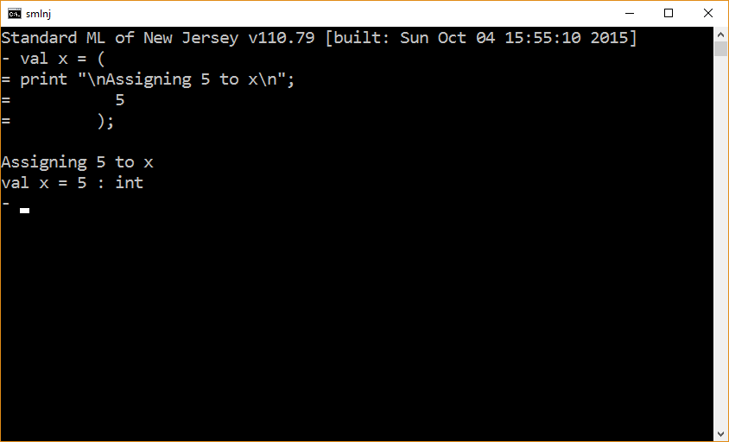

Slide 9
The let-block
An expression with a scope

Slide 10
Syntax
expression ::= letBlock | …
letBlock ::= “let” decarationList “in” blockBody “end”
decarationList ::= ε | declaration declarationList
blockBody ::= expressionSeq

Slide 11
let
val id₁ = expr₁
…
val id_{n} = expr_{n}
in
… id₁ … id_{n} … id₁
end
keywords
declarations
blockBody

Slide 12
Let-blocks
A let-block consists of an initializing declaration list (the part between the keywords “let” and “in”) and a body (an expression between the keywords “in” and “end”).
A declaration list is a list consisting of 0 or more declarations.
A let-block defines a scope.
The declarations in a let-block are statically scoped.
A let-block is an expression whose value is the value of its body.

Slide 13
Example 1
let
in
print “\n5\n”;
print “\n4\n”;
print “\n3\n”;
print “\n2\n”;
1
end;

Slide 14
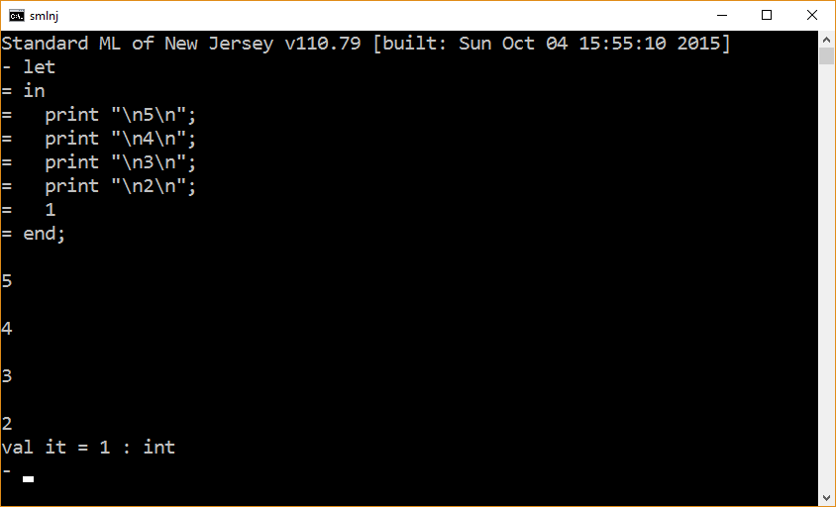

Slide 15
Example 2
let
val x = 5;
val y = 6;
in
print “\nreturning the tuple (x,y)\n”;
(x,y)
end;

Slide 16
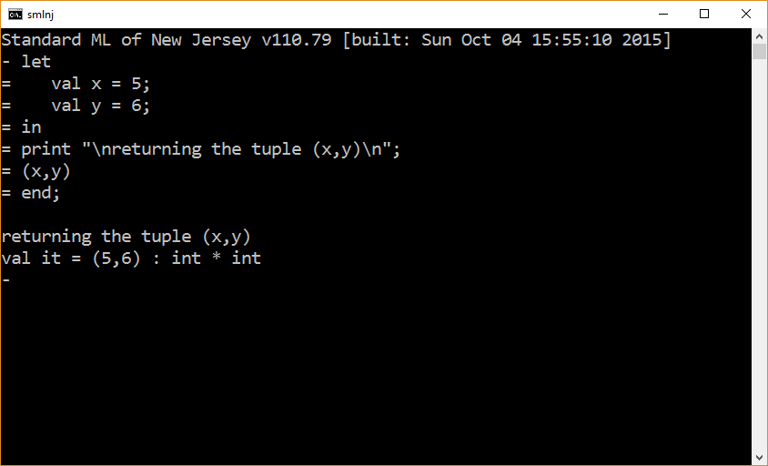

Slide 17
Example 3
val g = let
val x = 5;
fun f y = x + y;
in
f
end;
g 6;

Slide 18
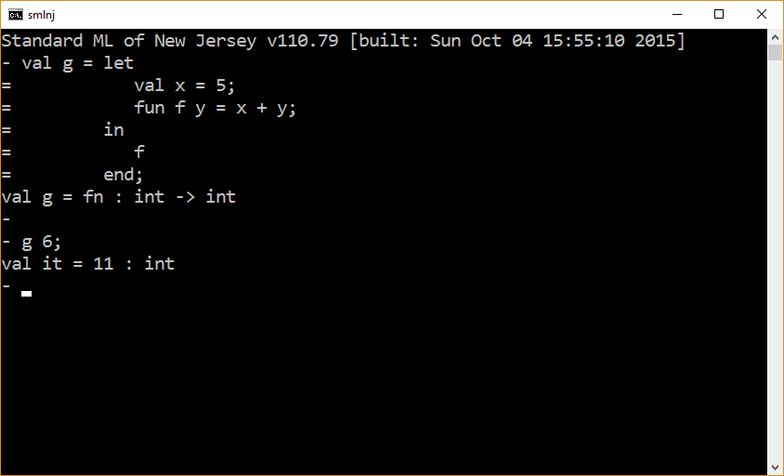

Slide 19
The end

